Slide 1
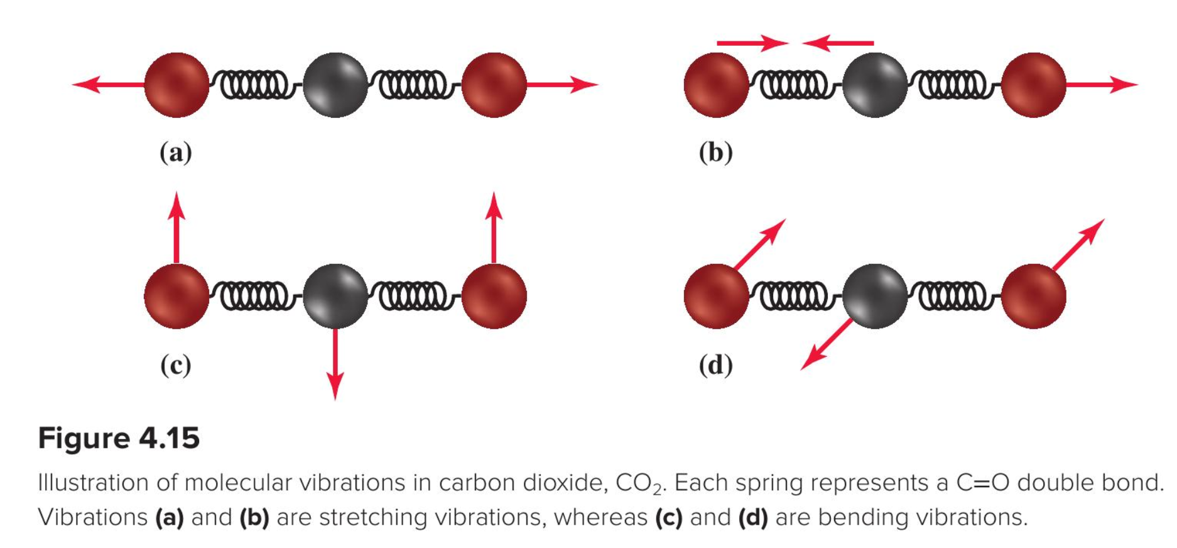
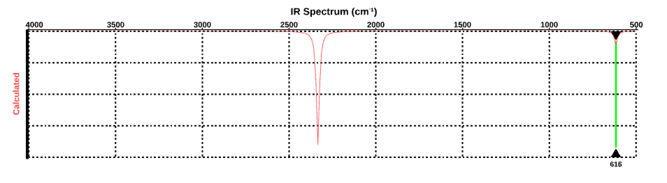
The bend is “IR-active”
We say the bend is IR-active because it absorbs photons (616 cm⁻¹)
Figure 4.5 in your text

Slide 2
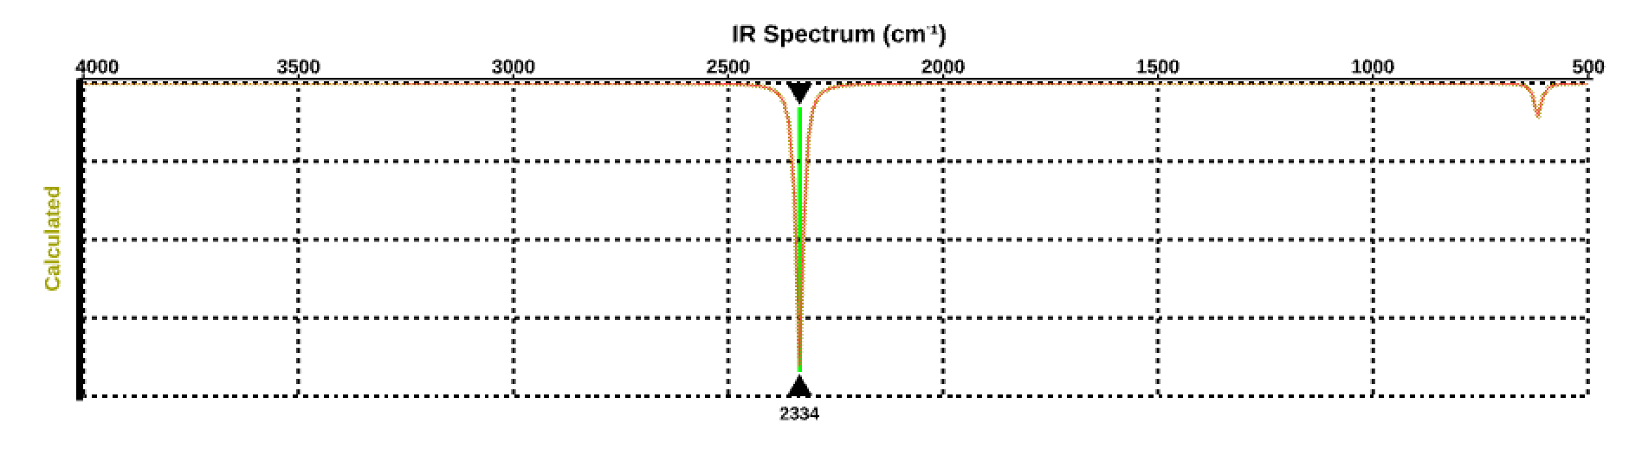
The asymmetric stretch is “IR-active” too
We say the asymmetric stretch is also IR-active because it absorbs photons too (2234 cm⁻¹)
Figure 4.5 in your text

Slide 3
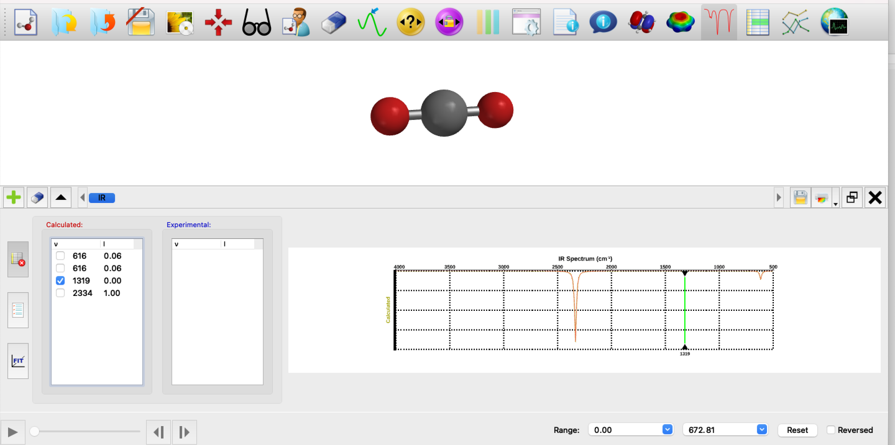
The symmetric stretch is “IR-inactive”
IR-inactive means it doesn’t absorb light, even if the light has the right wavelength/wavenumber
You can tell it’s IR-inactive because of the zero next to it

Slide 4
Why is the symmetric stretch IR-inactive?
-
+
-

Slide 5
Why is the symmetric stretch IR-inactive?
-
The light can’t move the partial negative charges up and down at the same time!
+
-

Slide 6
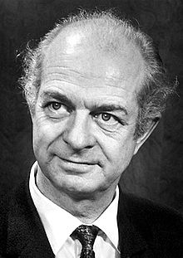
A way to predict polarity: electronegativity
Even before Rutherford and Schrödinger, experimentalists knew about the imbalance of charge within molecules – they called it molecular polarity. Those ideas led to the concept of electronegativity (“EN”).
Electronegativity: the tendency of an atom within a molecule to draw electron density toward itself. Molecules in which atoms have a big difference in EN tend to have big charge imbalance
Linus Pauling
1901-1994

Slide 7
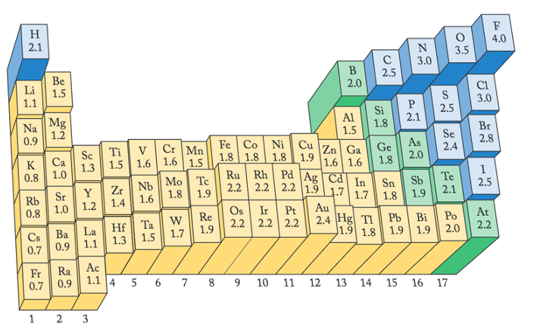
Trends in electronegativity
Increasing EN

Slide 8
Trends in electronegativity
Increasing EN
Exactly how do we use EN to predict polarity? Look for atoms that are bonded to each other that have a big difference in their EN.

Slide 9
Predicting polarity using electronegativity
Let’s do some predicting …
The molecule HF should be
Polar, negative side on the F
Polar, negative side on the H
Not polar
Increasing EN

Slide 10
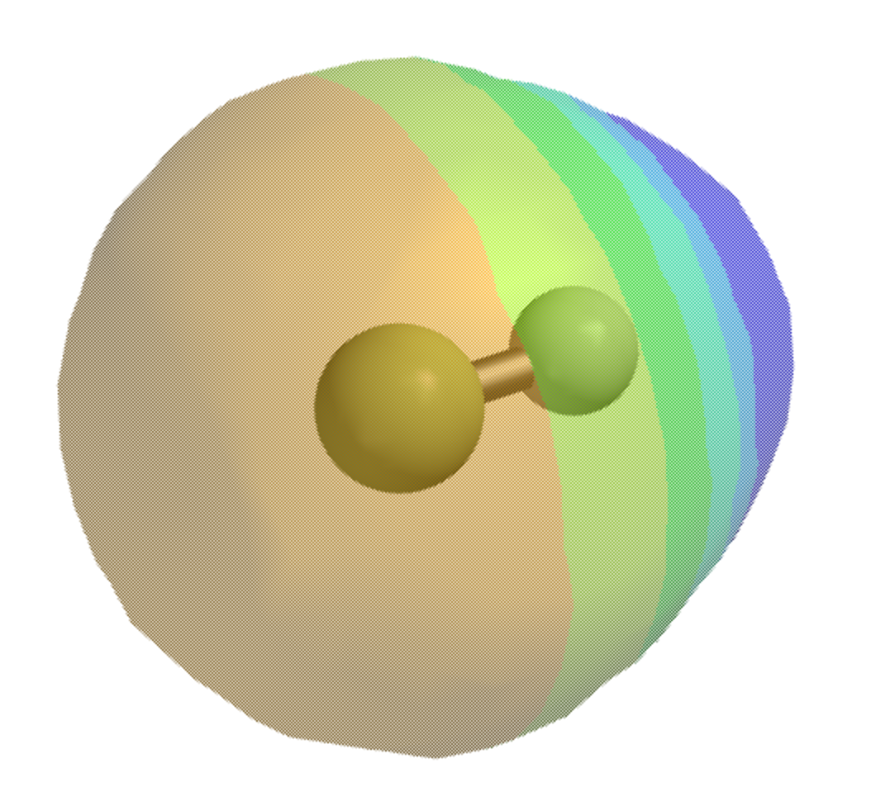
Predicting polarity using electronegativity
Let’s do some predicting …
The molecule HF should be
Polar, negative side on the F
Polar, negative side on the H
Not polar
Increasing EN

Slide 11
Predicting polarity using electronegativity
Let’s do some predicting …
The molecule CO₂ should have
Polar bonds, negative toward the Carbon
Polar bonds, negative toward the Oxygens
Increasing EN

Slide 12
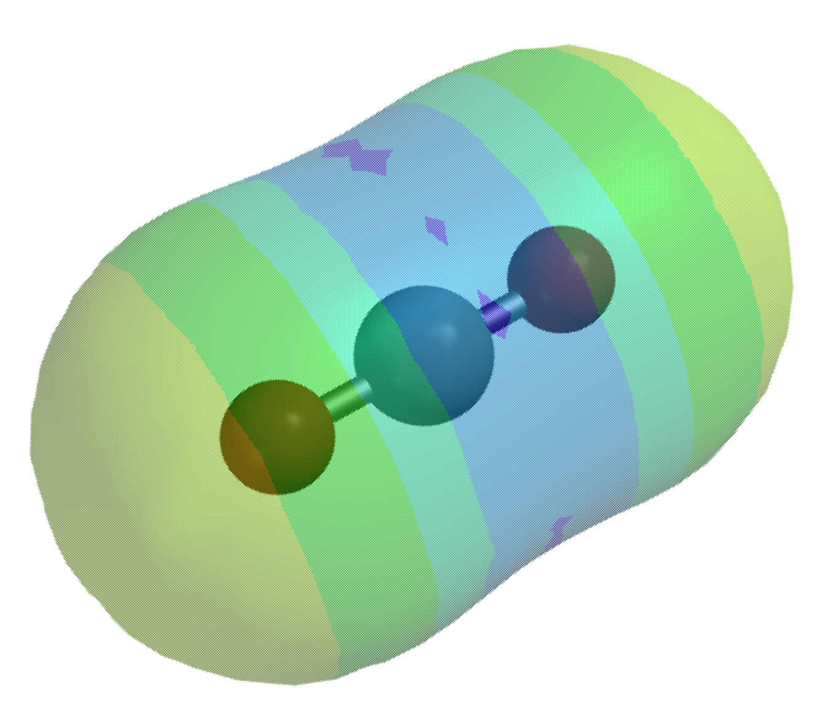
Predicting polarity using electronegativity
Let’s do some predicting …
The molecule CO₂ should have
Polar bonds, negative toward the Carbon
Polar bonds, negative toward the Oxygens
Increasing EN

Slide 13
Lab this week
Activities
Identification of an unknown salt (Bunsen burner) and an unknown gas (Geißler tube)
Using an FTIR spectrometer to examine absorption spectra
Learning objectives
Firm up your mental representation of the relationship between vibrational motion and the absorption of longwave radiation (in this case, IR)

Slide 14
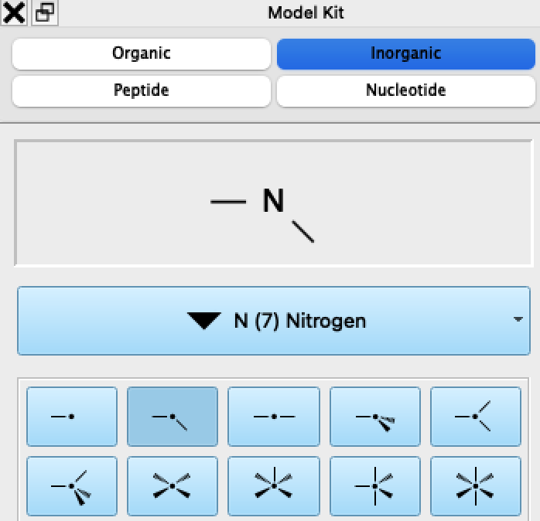
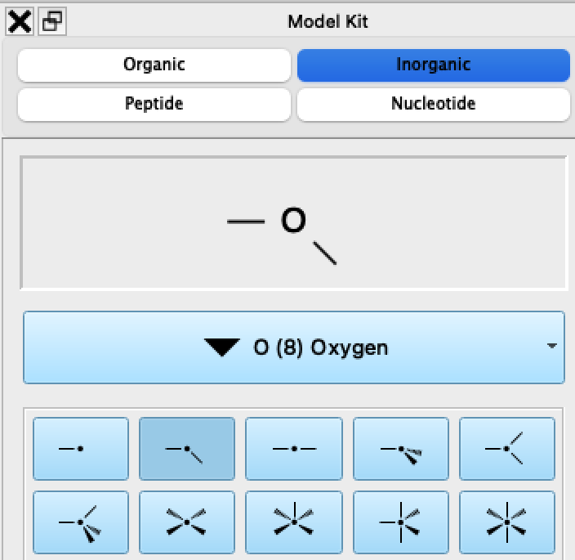
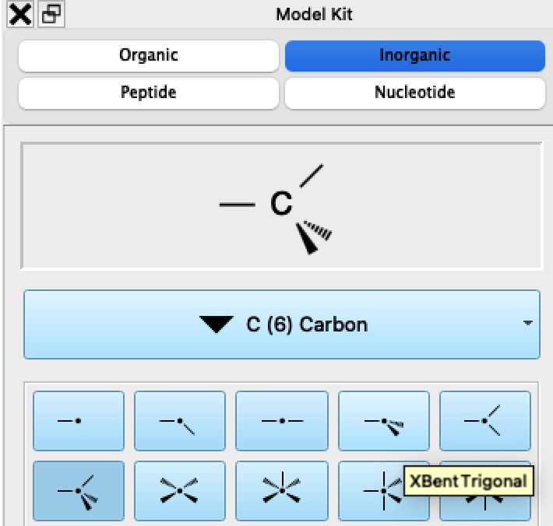
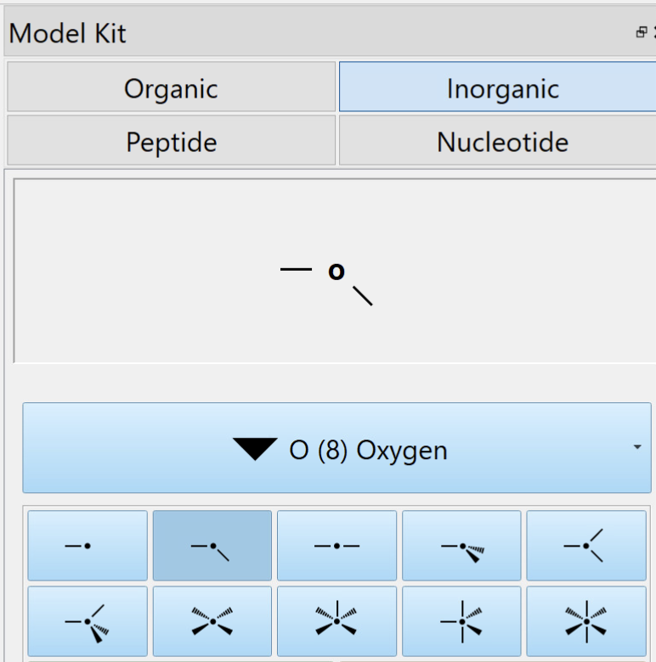
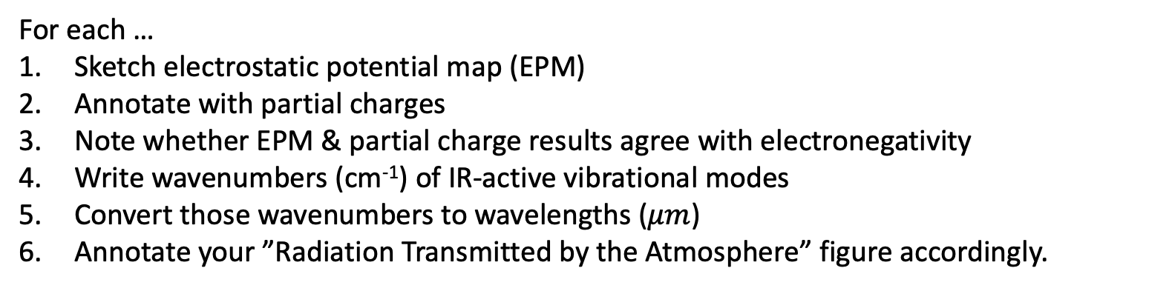
Lab handout: Analysis of H₂O, CO₂, O₃, CH₄, and N₂O
Replace one H with O; replace other H with N
Yellow lines default to H
Replace both H’s with oxygens
For each …
Sketch electrostatic potential map (EPM)
Annotate with partial charges
Note whether EPM & partial charge results agree with electronegativity
Write wavenumbers (cm⁻¹) of IR-active vibrational modes
Convert those wavenumbers to wavelengths ($μm$)
Annotate your ”Radiation Transmitted by the Atmosphere” figure accordingly.

Slide 15
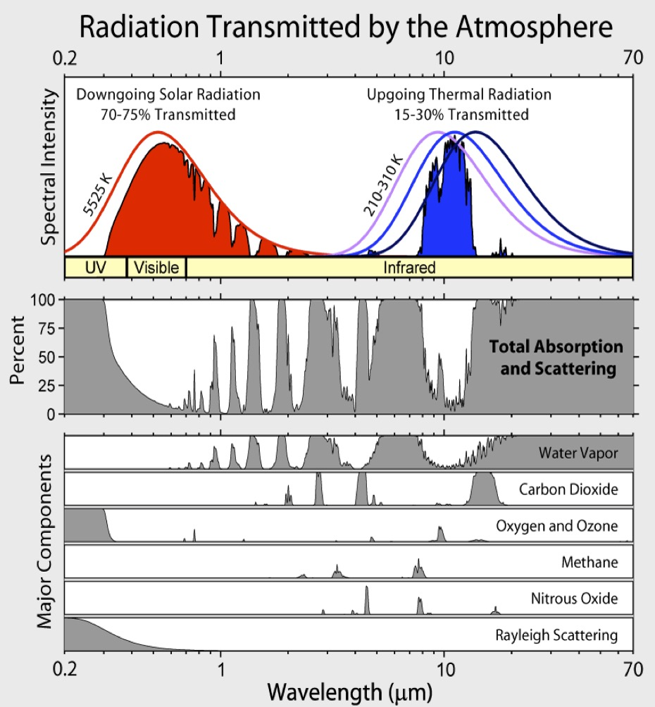
Lab handout: Analysis of H₂O, CO₂, O₃, CH₄, and N₂O

